Slide 1
Introduction
Unit 1

Slide 2
Roadmap
1. Introduction.
1.1. External and internal history.
1.2. Language change occurs at all levels.
1.3. Variation, change and evidence of change in progress.
1.4. Attitudes towards change.
1.5. Internal history of the English language: an overview.

Slide 3
External history
External history is concerned with the socio-historical events that have happened to the speakers of a particular language.
Cultural events
Changes in ideology
Economic and social changes
Political changes
Scientific changes
Language is so basic to human activity that there is nothing human beings do that does not influence and, in turn, is not influenced by the language they speak.
(Algeo 2001: 1)

Slide 4
Internal history
Internal history is the record of the linguistic developments of a language over time, how its vocabulary, grammar and phonology have changed.
Loss of a linguistic element
Medieval night [niçt] [ç] was lost
Addition of a linguistic element
Get passive
Recategorization of an element
after preposition > after conjuction

Slide 5
External and internal factors
Language change is usually caused by both external and internal factors.
Norman Conquest --- contact --- borrowing --- competition --- lexical obsolescence / semantic change

Slide 6
Levels of language
Phonology
Morphology
Derivational
Inflectional
Syntax
Close connection between morphology and syntax
Semantics
Pragmatics

Slide 7
Change at the different levels
Lexical and semantic change affects the vocabulary of a language and the semantics of vocabulary items.
OE eam vs. PDE uncle
OE brid vs. PDE bird
Pragmatic change, i.e. changes of meaning in context.
nigger

Slide 8
Change at the different levels
Phonological and spelling changes, affecting the sounds of a language and their graphic representation.
OE stān /sta:n/ > ME stone /stɔ:n/
OE brōhte ['bro:xte] > ME brouʒte /'brouxtǝ/ > PDE brought /brɔ:t/
<h> <ʒ> <gh> for /x/
pleasure /'pleʒǝ/ < /'plezjǝr/
Caribbean /ˌkærɪˈbiːən/ vs. /kəˈrɪbiən/
OE cild > ME child
<c> and <ch> for /t∫/

Slide 9
Change at the different levels
Morphological change, affecting the words and morphemes of a language.
3rd person plural pronouns
3rd person singular present indicative inflection
Plural inflections, e.g. OE bec ‘books’ vs. PDE books
Syntactic change, i.e. change affecting the rules regulating the combinatory possibilities of words.
Yet he knew me not at first. He said I was a fishmonger. […] I'll speak to him again. (to Hamlet) What do you read, my lord? (Ham. II, ii)

Slide 10
The language of shakespeare…
Is it thy will, thy image should keep open My heavy eyelids to the weary night? Dost thou desire my slumbers should be broken, While shadows like to thee do mock my sight? Is it thy spirit that thou send'st from thee So far from home into my deeds to pry, To find out shames and idle hours in me, The scope and tenor of thy jealousy? O, no! thy love, though much, is not so great: It is my love that keeps mine eye awake: Mine own true love that doth my rest defeat, To play the watchman ever for thy sake: For thee watch I, whilst thou dost wake elsewhere, From me far off, with others all too near.
(1609, William Shakespeare, Sonnet 61)

Slide 11
Variation and change
Languages are in a constant state of flux
Variation is inherent in languages
Regional
Social
Personal
Temporal

Slide 12
Sources of variation
Differences in production
Imitation/accommodation
Analogy
Differences in language acquisition
Contact
‘Playfulness’

Slide 13
Variation and change: two sides of the same coin
[Language] change is, for want of a better phrase, quite 'messy' indeed. […] This means that change contributes to synchronic variation in a language system -old and new, and new and new variants may co-exist at any one time in a speech community. It also has diachronic effect -as some variants become dominant and are retained and others are lost, the 'linguistic character' of the language [...] also changes. (Singh 2005: 35-36)
-(e)th vs. –(e)s
Change needs prior variation; variation may not lead to change, but remain stable.

Slide 14
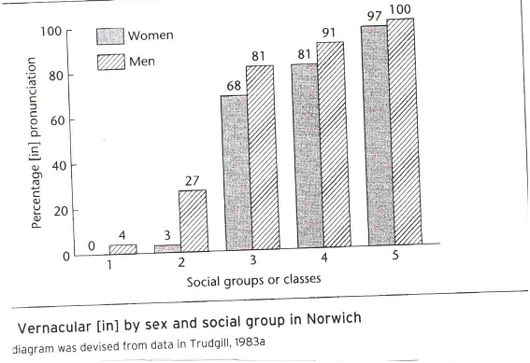
Stable variation: Variation not leading to change
-ing, with its two variants [-iŋ] vs. [-in]
Standard vs. non-standard
Degree of formality
Social class/education
Gender
Evidence for [-iŋ] vs. [-in] variation in earlier English
Spellings
Rhymes

Slide 15
Attitudes towards change
Language change seen as decay
“Tongues, like governments, have a natural tendency towards degeneration” (1755. S. Johnson)
Milroy and Milroy ‘s (1999) ‘complaint tradition’. Two different aspects →
Type 1 complaints are rather "legalistic" and concerned with correctness. They "attack 'mis-use' of specific parts of the phonology, grammar, vocabulary" (1999: 31).
Type 2 complaints are rather "moralistic" and "recommend clarity in writing and attack what appear to be abuses of language that may mislead and confuse the public" (ibid.).
“Many linguistic changes are perceived as decay (...) [as a] decline of culture and tradition” (Burridge & Bergs 2016: 21-2)

Slide 16
Attitudes towards language change
Language change seen as evolution
Language is seen as an evolving organism, it changes for the better.
Jespersen → English move towards analyticity seen as a simplification and therefore an improvement
IO OE dative case Se munuc geaf bōc þæm cyninge
PDE word order The monk gave the king a book
PDE PP The monk gave a book to the king

Slide 17
Attitudes towards language change
Language change: neither progress nor decay
[L]anguage change represents the status quo, neither progress nor decay, where every simplification is balanced by some new complexity” (Brinton & Arnovik 2006: 21). This is the prevalent view of modern historical linguistics.
Needless to say, the job of linguists is not to be prescriptive in any sense; i.e. we do not evaluate whether particular changes are good or bad. Rather, linguists work descriptively and simply document whatever is happening in the language without evaluating this from a "right or wrong" perspective. For linguists, language is a natural (even if social) phenomenon, something that evolves and adapts and can be studied objectively. (Burridge & Bergs 2016: 22)

Slide 18
Internal history of English: An overview
PERIODIZATION
Old English (OE) 450-1150 Germanic invasions to Norman Conquest (1066)
Early OE (700-900) vs. Late OE (900-1150).
Middle English (ME) 1150-1500 Norman Conquest to Tudor dynasty (1485)/ printing press (1476, Westminster)
Early ME (1150-1350, the date of the birth of Chaucer) vs. Late ME (1350-1500).
Modern English (ModE) 1500 onwards
Early ModE (1500-1700)
Late ModE (1700-1900)
Present-day English (PDE) 1900→

Slide 19
Modelling linguistic change
Languages do not change at a constant rate [...] There can be periods of speeding up and periods of slowing down. (Burridge & Bergs 2017: 4-5).
Languages may vary all the time, but they change in bursts. Lass (1997: 304)

Slide 20
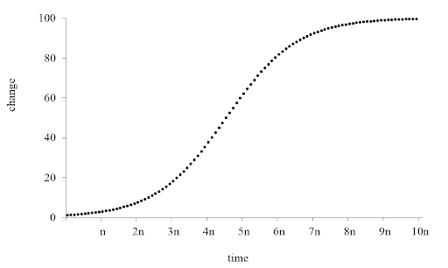
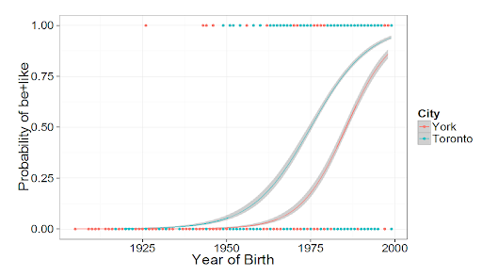
The s-curve: Slow, slow, quick, slow
Real time
Apparent time
http://www.helsinki.fi/varieng/series/volumes/16/tagliamonte/

Slide 21
Internal history of English: An overview
Lexical change: in all periods; but ME, EModE, LModE have experienced ‘bursts’
Semantic change: in all periods
Phonological change: in all periods
Morphological change: especially Late OE and ME, but ongoing changes (e.g. regularization of irregular verbs)
Syntactic change: in all periods, but ME rise of verb periphrases; Modern English, get-passive, gzn of the progressive; changes in argument structure…
Pragmatic change: all periods

Slide 22
Thank you!
Please leave your questions and comments in the forum for Unit 1

